Slide 1
AI Work Transformation Summary
Jeff Anderson
Ashley Beattie
6 October 2025

Slide 2


XXX wants to maximize successful adoption of AI Workforce Enablement
AI Adoption is A key Imperative for RBC CDN Banking IT Group
XXXX is where in the journey
XXXX leadership have seen the potential of delivering through disciplined human/AI pairing firsthand through Electric Mind’s workshops
XXX wants to increase productivity through adoption of AI Workforce Enablement across their organization
Our Proposal
Electric Mind is pleased to offer a 10 week fixed price engagement for $300,000.
Scope is comprehensive and will examine people, process, technology and tools from project and change inception through delivery to production.
Our engagement will produce three outcomes:
Current State Summary & Scorecard, including a rigorous maturity assessment.
Target State Definition & Gap Analysis across people, process and technology.
Prioritized Implementation Roadmap, including identification of any “quick wins”.
XXX has asked Agile By Design to review AI adoption readiness and develop an actionable roadmap
RBC is excited by the opportunities, but is concerned with the risk
Something something dark side EM is awesome
Electric Mind is uniquely positioned to deliver a strategy that builds trust, grows talent, and embeds AI safely and sustainably
Slop — lazy use of AI makes undisciplined practices worse, poorly monitored use can result in catastrophic error
Dysfunction — AI amplifies a broken system to be worse, faster
Morale — If AI is seen to replace people adoption will stall
Fit — big bang, one size fits all limits value and confuses teams
Bias - AI may internalize, then scale your worst assumptions
Intentional AI Delivery will be the core, informed by our leading-edge AI pairing experience and decades of modern methods delivery
Simplicity will guide us, benefiting from our experience in better ways of working.
Mentorship our passion for levelling up your people will set the tone
Contextual the strategy will promote incremental change, pairing at all levels
Industry our intimate understanding of Canada’s FIs include countermeasures meant to protect against AI induced error and bias
We are embedded in industry. We are active service providers to most of Canada’s financial institutions, with intimate understanding of operating best practice and expectations for the industry.
ABD can help XXX move from vision to execution readiness while avoiding costly missteps

Slide 3
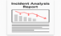
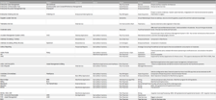
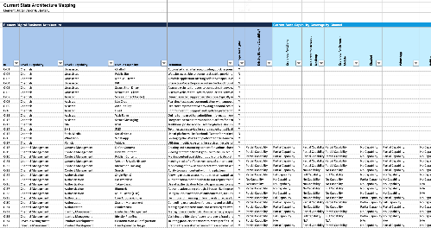
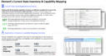
ABD proposes a strategy that will bring Clarity, Direction, Momentum to your AT enablement journey
The 12-week engagement will produce four distinct deliverables which will enhance understanding, and position the organization to accelerate AI adoption and integration for productivity benefits.
Detailed Assessment Report
Target State
Roadmap
Executive Summary
Insights into the current state AI workforce readiness
People, Process and Technology target
The step we take toward transform to AI workforce readiness
A concise summary of key findings, recommendations, and the finalized target state with next steps for stakeholder approval.
Comprehensive Maturity Assessment
Objectives and Outcomes
Systemic Barriers to Adoption
Culture and Capability Gaps
Key Risk Assessment
Change Readiness Analysis
Vision and Principles
Target Operating Model
Technology Options / Impact
Governance and Risk Approach
AI Enablement / COE Services
Adoption Approach
Success metrics
Incremental Adoption Plan
Pilots / Quick Wins
Enablement / COE Plan
Technology Implementation Plan
Skills development plan
Change enablement plan
Quarterly Outcomes and Key Results
ROI based prioritization and sequencing
Key findings and recommendations
Current State Maturity Level and key gaps
Prioritized productivity opportunities with ROI estimates
High-level transformation roadmap with resource requirements

Slide 4
Our Approach
Phase 1: Strategic Alignment and Current State Discovery
Phase 2: Organizational Maturity Evaluation
Phase 3: Productivity Opportunity Identification
Phase 4: Strategy Development
and Roadmap
Key Activities:
Conduct executive stakeholder interviews
Deploy workforce surveys and focus groups to assess change readiness, skills gaps and cultural barriers to AI adoption
Outcomes:
Clear understanding of leaders' vision and strategic alignment between AI initiatives and business objectives
Baseline assessment of workforce readiness
Initial AI maturity scores
Visibility into key areas for further evaluation
Key Activities:
Complete comprehensive AI maturity
Conduct value stream mapping and flow and friction analysis of E2E workflows
Analyze technical infrastructure, data arch., and AI integration capabilities
Outcomes:
Comprehensive AI maturity scorecard with gap analysis and benchmark against industry peers
Complete value stream maps highlighting productivity improvement opportunities
Technical Readiness assessment for AI
Key Activities:
Facilitate workshops to identify and prioritize high-impact AI use cases
Develop ROI calculations for top productivity opportunities and prioritize for quick wins and strategic opportunities
Conduct skills and role impact analysis of current positions vs. future AI-augmented roles
Outcomes:
Prioritized portfolio of 8-12 AI use cases with detailed business case & ROI projections
Strategic opportunity roadmap
Key Activities:
Synthesize assessment findings into an AI workforce productivity strategy
Develop 24 month transformation roadmap
Design change management and capability development plans
Outcomes:
Complete AI workforce productivity strategy
Detailed implementation roadmap
Integrated change management plan
Week 1
Week 2
Week 3
Week 4
Week 5
Week 6
Week 7
Week 8
Week 9
Week 10
Week 11+
Program Kickoff
Artifact collection and analysis
Action roadmap based on priorities
Conduct SME interviews
Update based on the plan
Confirm baseline & score carding
Scorecard
Draft
Identify and socialize targeted quick wins
Remediation Plan Draft
Refine delivery controls and gating
Define target state delivery framework
Stakeholder signoff
Develop future roadmap
Align Stakeholders
Legend
Status meeting
Governance meeting
Phase Milestone

Slide 5
Electric Mind’s Perspective on AI Workforce Enablement

Slide 6
From 2020-2025, the AI Maturity Landscape has dramatically shifted, with substantial acceleration towards transformation.
2020
2025
Most organizations have operational experience with AI, though true end-to-end transformation is rare.
52%
35%
27%
20%
25%
14%
10%
10%
5%
2%
Stage 1
Stage 2
Stage 3
Stage 4
Stage 5
Exploring
Experimenting
Formalizing
Optimizing
Transforming
Exploring what AI is and what is can bring to your org.
Experimenting with POCs and pilots.
Moving from POCs/Pilots to AI solutions in production.
Scaling AI solution deployments.
Transforming the organization through the use of AI.
Notes:
Paradigms
Situating the maturity stages
Past 5 years
Moving from experimental, operational, transformational
-- Source element AI

Slide 7


AI has significant Implications across the Technology Delivery lifecycle
AI IS TRANSFORMING THE WAY WE WORK
We are now entering an “everyone is a builder” economy. New apps can launch in days—not months or years. Business agility no longer needs to be crippled by specialist silos or brittle handoffs
AI enables speed without compromising safety or governance
COMPETING IN THE AI ERA REQUIRES A MINDSET SHIFT
IT Management’s job will change toward providing teams with context, not with control. Real gains in IT delivery will require moving beyond today’s highly functionalized organization. Critical thinking, bus/tech fluency, and adaptability will be required across entire the IT workforce.
Winning with AI means shifting from managing our work to accelerating our thinking.
AI ADOPTION BRINGS REAL RISK
Papering over organizational dysfunction with AI will multiply that dysfunction. AI requires clean, well-maintained digital artifact, an end to poor practice /poor hygiene. Tooling must integrate seamlessly with AI while remaining fit for purpose. Culture will fight back - leading requires a fundamentally different approach to change.
The real risk with AI isn’t the tech— it’s carrying yesterday’s habits into tomorrow’s tools
LEARN FROM AGILE—BUT DON’T REPEAT ITS MISTAKES
Agile is both a cautionary tale, and catalyst for further change, acting as a launchpad for AI-augmented work. Centralize strategy: vision, principles, incentives, and building enablers. Execute change locally with sustainable, incremental change. Be inspiring in vision bit pragmatic in execution; above all avoid another big bang change.
Real change happens in steps - pacing and learning matter more than planning

Slide 8




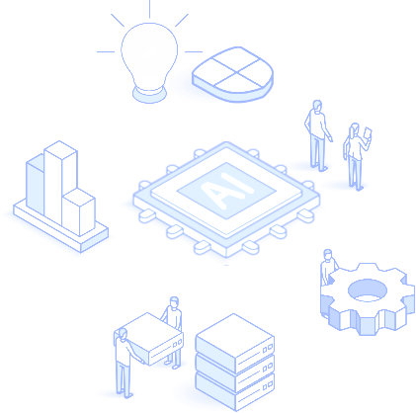



AI-driven mindset, practice, and tools will accelerate the entire delivery lifecycle
Opportunity Refinement
AI brings business context to IT quickly – clarifying the problem, sizing the effort, and surfacing the value.
Stakeholder goals, risk signals, IT capability, are used to generate business cases, roadmaps, and credible delivery plans in hours
Accelerate alignment between IT and business partners
Validation
AI helps measure real-world impact - correlating user behavior and adoption to outcomes. Signals are tied back to hypotheses, enabling rapid learning and course correction, closing the gap between delivery and value.
Business and IT learn faster what’s working, —and what matters.
Scoping and Planning
AI listens to team conversations & workshops -artifacts are generated that align outcomes to scope & acceptance
AI helps extracts key decisions, drafts stories, define specs, and refine acceptance criteria
Handoffs across business and IT are faster & cleaner
Production
Integrated AI / CICD tooling predicts and even remediates deployment issues, and optimises release windows
AI monitors and detect anomalies, suggest optimizations, and even generate fixes.
Go lives are faster, more frequent and more reliable.
Engineering
AI brings context necessary to align needs to current systems and target architecture
Developer supervised agents generate well crafted code, accelerate integration, and ease system migration
Productivity and throughput increase, boilerplate work and design drift are eliminated.
Testing
AI auto-generates unit tests, integration contracts, edge cases, and test templates.
Test scaffolds are created in parallel with stories, shortening feedback loops and increasing test coverage. Human QA reviews, tunes and finalizes.
Testing is done earlier, deeper, and more frequently

Slide 9

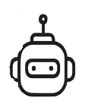


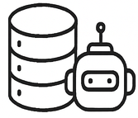

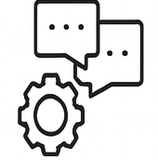

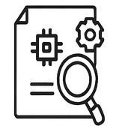
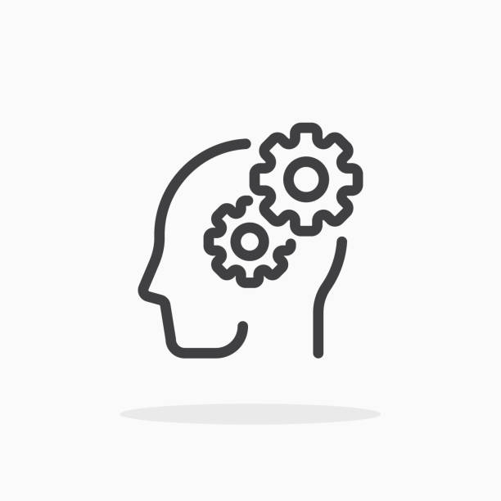
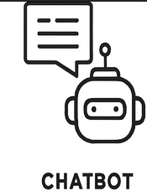


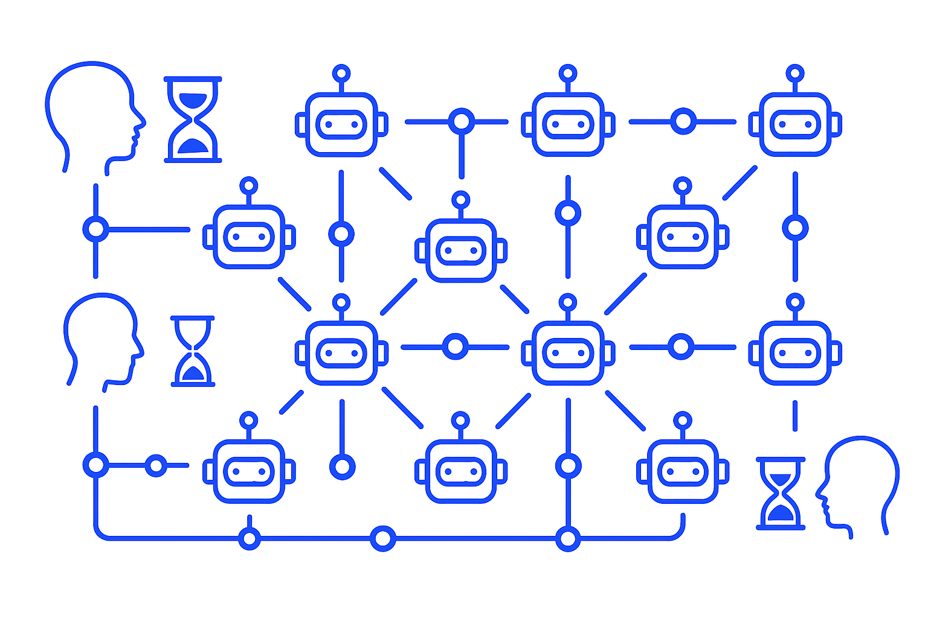
Change Strategy
Augmentation
Assess the system for high-leverage failure points. Introduce consumer-level AI and light workflow tweaks to maximize impact. Give your workforce superpowers.
Expand the case for change…
Ownership Channel early success to spark ownership. People tune, feed, and steward their own agents. AI boosts leader’s ability to provide their context at larger scale, share their knowledge, and raise standards.
Bring specialized context to the frontline increasing relevance, awareness, and alignment
Orchestration Momentum fuels broader alignment towards a simplification and more holistic improvement. Leaders, while remaining in charge - are responsible for amplifying their presence through a network of agent
Connect the enterprise, helping people act with purpose, and connect strategy to execution
Navigation
Success is about aiming human-in-the-loop effort where it matters most — critical judgment, values, and edge decisions.
Enable Humans to focus on values and judgment.

Slide 10
We will start by assessing your AI Workforce Readiness across these Key Dimensions
We will assess the bank's Canadian retail business across six critical dimensions of organizational readiness for AI workforce productivity improvement, enabling the creation of a comprehensive strategy.
What are the dimensions of a strategy to realize an "AI-Ready" organization?
Purpose and Strategy Alignment
Process and Workflow Re-design
Capability Development
Management systems and leadership behaviours
Mindset and cultural transformation
Measurement and continuous improvement
Strategic Alignment & Leadership
Operating Model Orientation
Data & Technology Infrastructure
Clear, value-linked AI agenda with executive ownership and funding; explicitly tied to priority outcomes.
Elements: Value thesis and prioritization, Leadership roles and Decision rights, Funding & partner strategy.
The org designs AI into how work gets done. End-to-end teaming is the default delivery model.
Elements: Value stream & Journey Analysis, E2E Teaming structures, Human-in-the loop controls, MLOps.
Trusted, accessible data and secure platforms support safe and reliable AI use at scale.
Elements: Data Foundation & Access, AI Platform & Integration Fabric, Observability & Trust.
Talent & Skills Readiness
Governance, Risk & Ethics
Culture & Change Management
The workforce is equipped to productively use AI, with roles and teaming patterns to unlock productivity.
Elements: Role-Based AI Fluency, New Roles & Teaming, Adoption Support & Enablement.
Policies and controls make AI safe, compliant and explainable, while enabling experimentation and learning.
Elements: Responsible AI Policy and Standards. Security and Privacy. Validation, monitoring and de-risking approaches, team-by-team enablement.
A culture that readily accepts AI-driven change. Leaders and teams are continuously learning and improving.
Elements: Presence of a trust narrative &
a human-focused AI adoption narrative. New ways of working with AI change playbook. Continuous improvement loops.
What does a "ready" organization look like?
Technical Infrastructure
robust data architecture
Modular AI platforms
Human in the loop systems
Organizational Capabilities
Cross-functional teaming
End-to-end teaming readiness (experience with this)
Change management excellence
Service Design
Learning culture
Service Design
Customer intimacy
Leadership and Governance
Strategic alignment
Ethical frameworks
Investment in people
Reinvention readiness
Notes:
Types of productivity improvements
Task automation
Accelerated decision making
Improved workflows
Quality improvements
Productivity levers
Skill amplification
System-level innovation

Slide 11
Next: Align on principles that ground a fundamental re-think of our organizational operating system
As organizations adopt and integrate AI, they need to customize and align on the principles will acts as a True North for their change efforts
Organize around Outcome Oriented Teams
The core building block for AI-driven agility
Hierarchical structures and functional silos block flow of context
Context preservation enables speed of work and decisions
Outcome oriented teams ensure context-aware accountability, clarity, and rapid opportunity response
Simplify the Way We Work
Prioritize removing friction and delay with AI
if the workflow is dysfunctional, AI will amplify it, reversing capacity gains
eliminate toil, destroy barriers to collaboration, remove bottlenecks, reduce manual control
(Re-)Design for adaptability
Design AI-powered systems that flex to meet diverse user needs and problem domains
Pair modular solutions with modular organizational design to enable rapid reconfiguration while limiting change fatigue
Standardize on interfaces but be tolerant of implementations that emerge bottom up
Champion Humanity and Learning
Deploy AI to leverage and augment human expertise and creativity, key to shifting culture
Focus on human-in-the-loop feedback where humans orchestrate, validate, improve and override
Invest in upskilling talent in meta-skills: judgment, facilitation, systems thinking, AI usage / stewardship.
Foster cultures of experimentation, transparency, and learning, rapid failure adaptation is required
Design for your (unique) Value
Don't just deploy tools because they're available
Center work design around mission, market needs and employee meaning, with AI as a tool to unlock, not dictate, outcomes
Notes:
Comlpiance constraints will make the hybrid operating model difficult

Slide 12
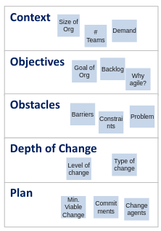
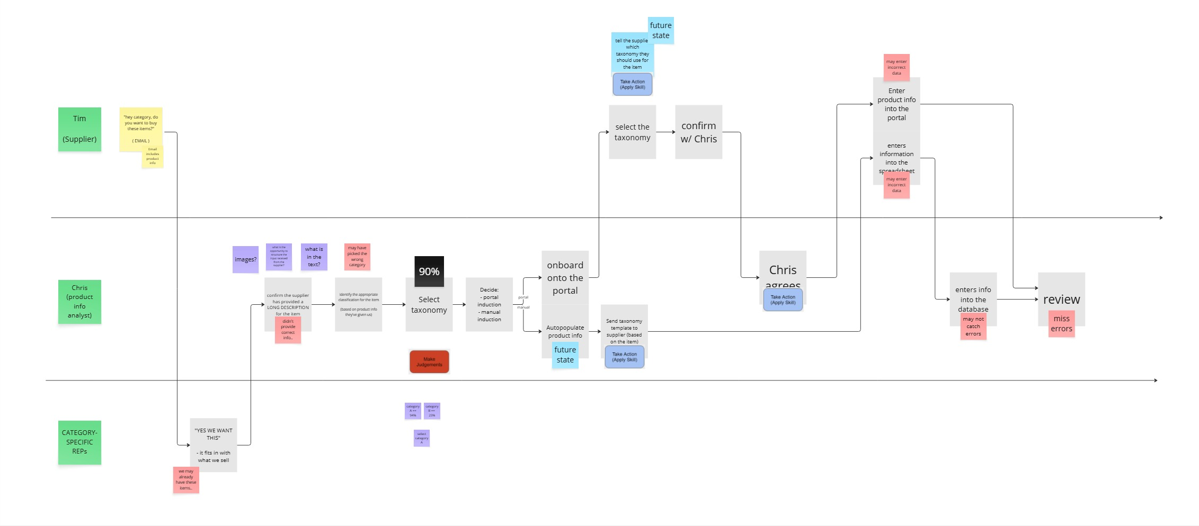
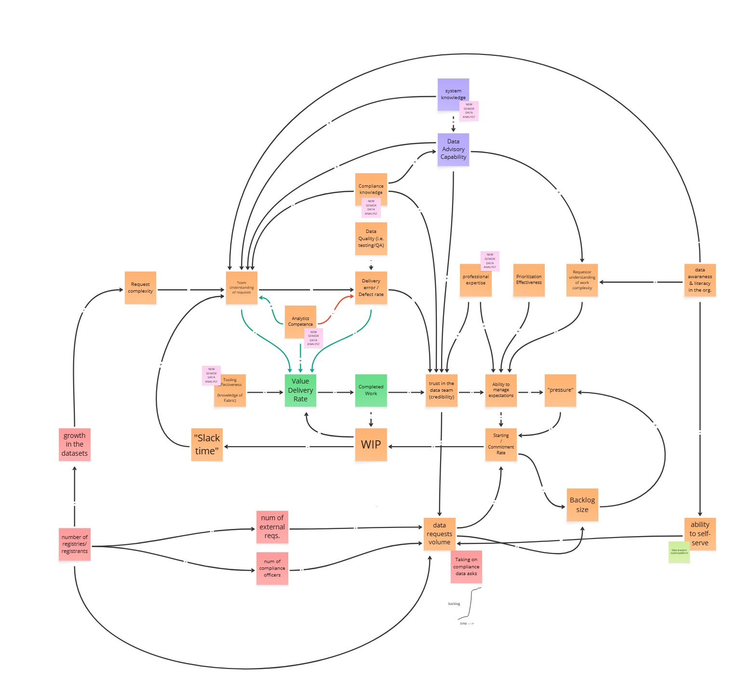
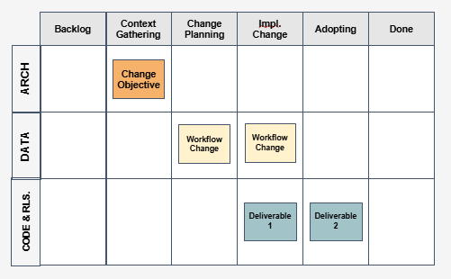
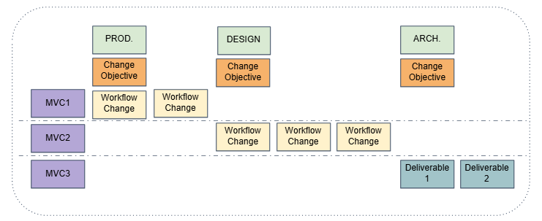
How we aligned our Client toward an AI enabled system of work
3
1
Co-design the change
Gather context
4
2
Visualize and co-deliver change
Map the system
Establish understanding of the domain, its change objectives and its change context
Pair with leads and SMEs & describe how teams collaborate to convert effort into outcomes.
Identify the systematic causes for issues, creating a shared mental model with stakeholders.
Incrementally deliver MVCs in partnership with change agents, visualizing and communicating change progress.
Change Canvas
Outcome-to-work Mapping
Causal Loop Diagram
Change Kanban
Identify areas of opportunity for AI-powered systematic change:
Multiple silos and handoffs
High exception rate
Toilsome and tiresome work
Decisioning delays & bottlenecks
Collaborative friction
Context fragmentation​
Partner with change adoptees to ideate, design, prioritize and sequence a backlog of Minimum Viable Changes (MVCs).
Transparently verify and validate the results of change, measuring (at a minimum):
System Effectiveness (Outcomes/Inputs)
Lead time vs. baseline
Throughput vs. baseline
Toil Reduction & change fitness

Slide 13


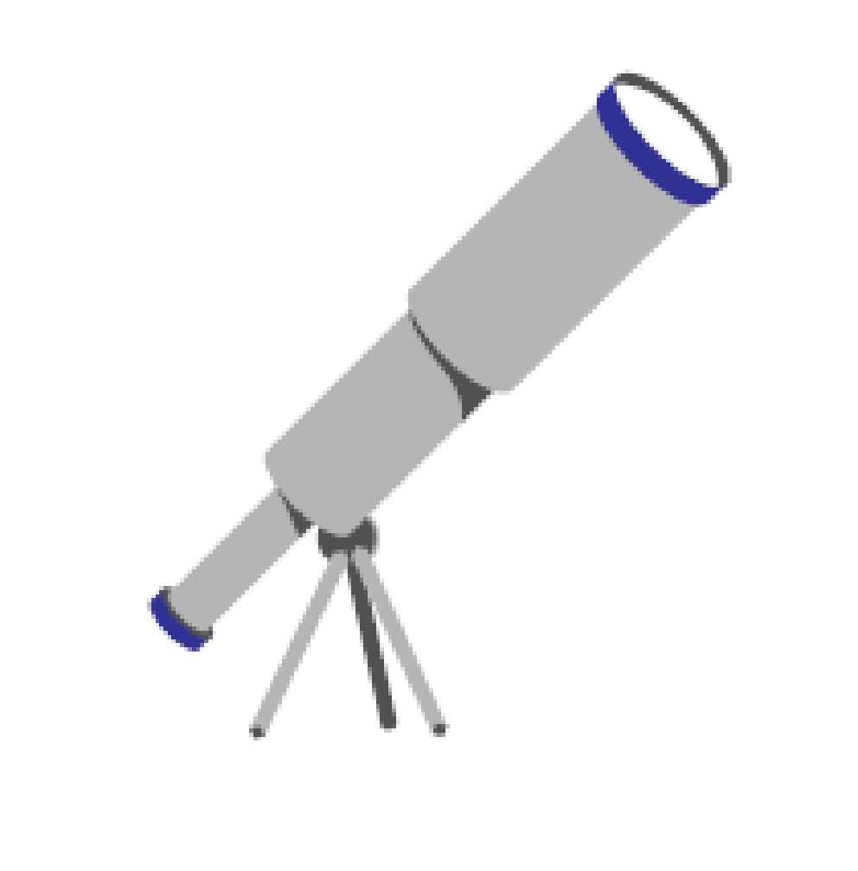

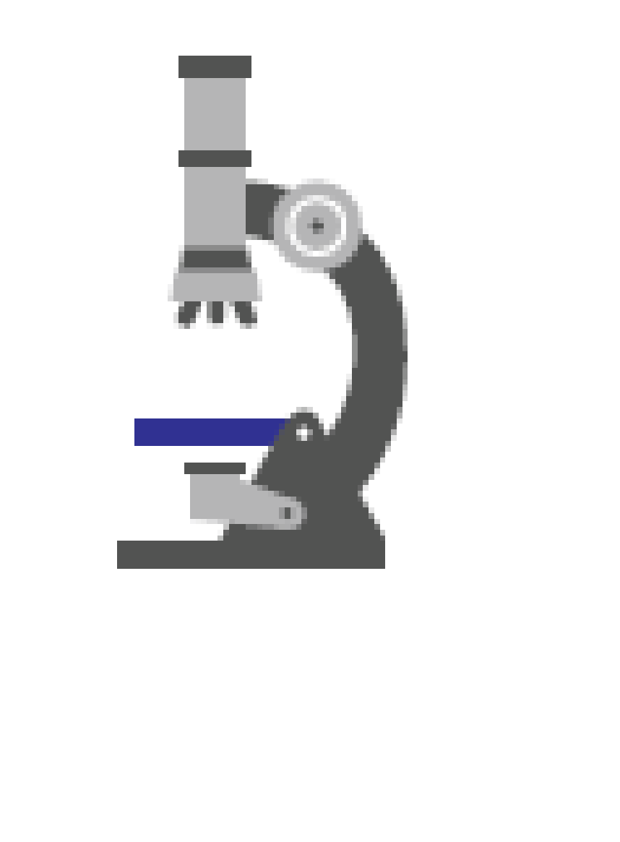

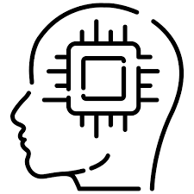
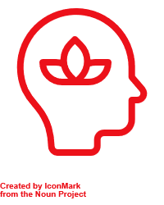

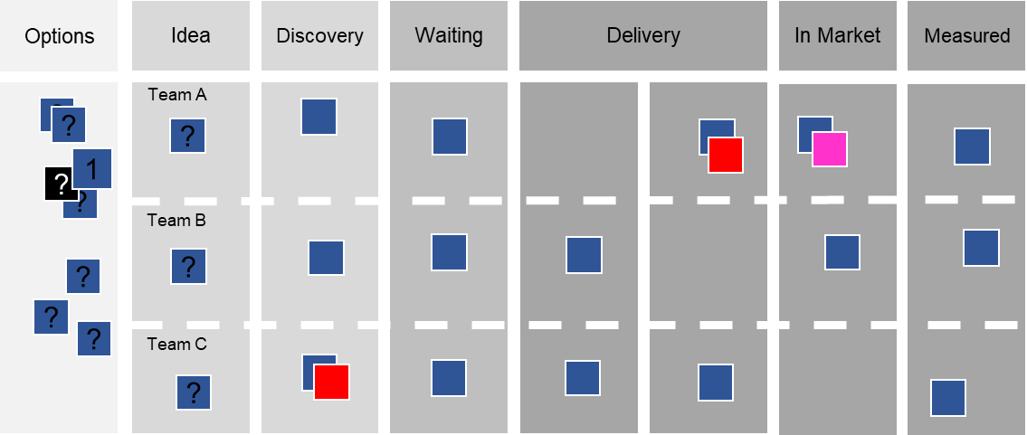
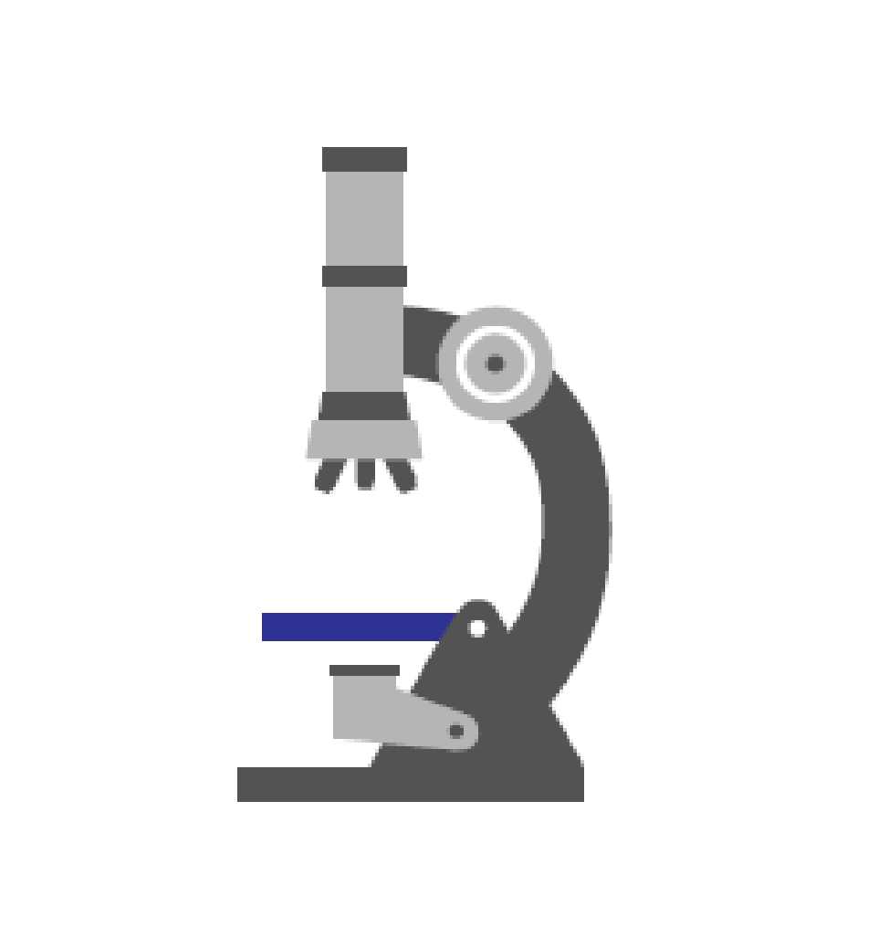

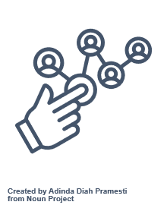

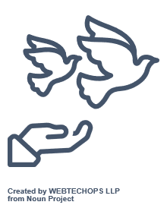

Incrementally Shift toward an AI enabled Operating Culture
Evolve your system of work through achieving tangible business outcomes
Start here
Expand the case for change…
…by leading value delivery through progressive practices
Credibility
Establish trust, understand the context, and prove our capability to use Gen AI to deliver better outcomes
Team Agent Pair(s)
Research
Idea
Discovery
Engineering
Ship
Embed with dev and adjacent functions, introduce AI pairing that show substantial faster delivery and improved quality
De-stress
Introduce simple, put powerful AI enable management practices that create focus and space necessary for thoughtful introduction of AI
Value Delivery Pair
Demand Balancing
Portfolio Flow
Bottleneck Removal
Coach Value Delivery Human AI pairs to use portfolio level prioritization, flow, and cadences to achieve transparency, collaboration and control
Behaviors that enable the change
Align
Design a outcome oriented, AI empowered, system of work; simpler to deliver, easier to govern
Context
Deliver and Learn
Change Agent Pair
Objectives
Observe
Introduce
Learn
Obstacles
Minimum Viable Change
Depth of Change
Plan
Co - Create
Facilitate the alignment toward a more comprehensive shift toward an AI mindset, and coach the organization on incrementally learning and adapting towards solutions that meet their context
Engage
Central functions stay highly engaged while introducing guidance through Agentic AI
Enable
Transparency, teamwork and feedback through AI enables an increase autonomy and accountability
Strategy
(org)
Outcomes
(portfolio)
Delivery
(Team)
Design, pair and coach Agentic AI / Human in the Loop Operating Model, across delivery, product, operations and governance that connect strategy to execution through rapid delivery and feedback
Notes:
Building cross-functional teams and decentralizing decision-making encourages people to think and act more systemically, success is no longer a zero-sum game
What really improves teamwork is working on the interactions between the parts, because that’s where the problem solving happens

Slide 14
How we aligned our Client toward an AI enabled system of work
3
1
Co-design the change
Gather context
4
2
Visualize and co-deliver change
Map the system
Establish understanding of the domain, its change objectives and its change context
Pair with leads and SMEs & describe how teams collaborate to convert effort into outcomes.
Identify the systematic causes for issues, creating a shared mental model with stakeholders.
Incrementally deliver MVCs in partnership with change agents, visualizing and communicating change progress.
Change Canvas
Outcome-to-work Mapping
Causal Loop Diagram
Change Kanban
Identify areas of opportunity for AI-powered systematic change:
Multiple silos and handoffs
High exception rate
Toilsome and tiresome work
Decisioning delays & bottlenecks
Collaborative friction
Context fragmentation​
Partner with change adoptees to ideate, design, prioritize and sequence a backlog of Minimum Viable Changes (MVCs).
Transparently verify and validate the results of change, measuring (at a minimum):
System Effectiveness (Outcomes/Inputs)
Lead time vs. baseline
Throughput vs. baseline
Toil Reduction & change fitness

Slide 15
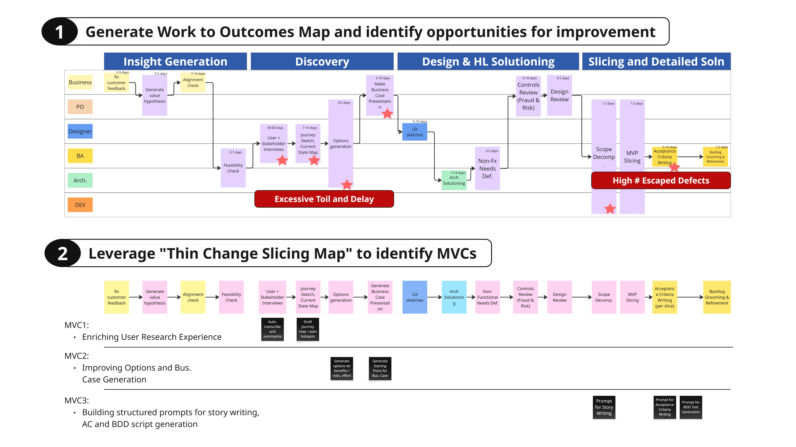
Agile discovery practices allowed us come up with an incremental AI enablement approach on our client’s top pain points
Notes:
We'd extend this based on our conversation last Friday
human -to-> human + agentic operating model (model 1 -> Model 2)
Essentially the industrialization of knowledge work
Human at the keyboard
Human + co-pilots *prompt library* w/ shared context
Supervised agents
Agentic modules

Slide 16
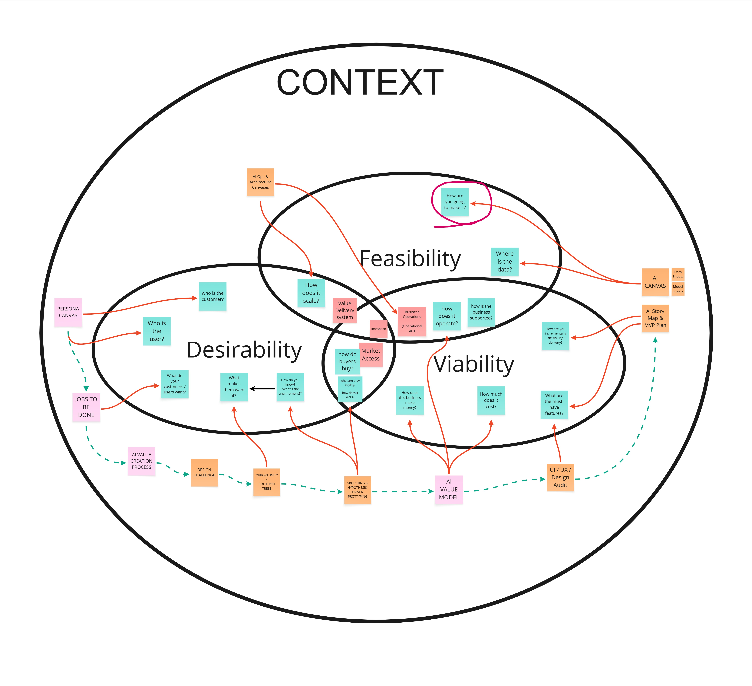
Our approach to de-risking AI Product Delivery
Over the past 4 years we've developed and tested a process that helps our clients incrementally de-risk their AI product development.

Slide 17
Our change approach
Establish credibility in context
Embedded with delivery and leaders
Co-design and co-deliver incremental, pragmatic, systematic change
We believe change sticks when it’s safe-to-try, measurable, and visible.
Progressively enable autonomy

Slide 18
RBC CDN Banking wants to maximize successful adoption of AI Workforce Enablement
AI Adoption is A key Imperative for RBC CDN Banking IT Group
RBC is ranked #1 in Canada and #3 globally among 50 global banks in 2025
RBC is building a serious AI foundation – from research (Borealis), infrastructure (Lumina, ATOM) to customer facing (NOMI, Aiden) to internal learning (AI Academy.
RBC is increasingly positioning AI as a core enabler of its growth strategy, and is moving forward with increasing it’s AI footprint across the organizations
CDN IT leadership have seen the potential of delivering through disciplined human/AI pairing firsthand through Electric Mind’s workshops
CDN Tech wants to increase productivity through adoption of AI Workforce Enablement across their organization
Our Proposal
Electric Mind is pleased to offer a 10 week fixed price engagement for $300,000.
Scope is comprehensive and will examine people, process, technology and tools from project and change inception through delivery to production.
Our engagement will produce three outcomes:
Current State Summary & Scorecard, including a rigorous maturity assessment.
Target State Definition & Gap Analysis across people, process and technology.
Prioritized Implementation Roadmap, including identification of any “quick wins”.
RBC CDN Banking has asked Electric Mind to review AI adoption readiness and develop an actionable roadmap
RBC is excited by the opportunities, but is concerned with the risk
Electric Mind is uniquely positioned to deliver a strategy that builds trust, grows talent, and embeds AI safely and sustainably
Something something dark side EM is awesome
Slop — lazy use of AI makes undisciplined practices worse, poorly monitored use can result in catastrophic error
Dysfunction — AI amplifies a broken system to be worse, faster
Morale — If AI is seen to replace people adoption will stall
Fit — big bang, one size fits all limits value and confuses teams
Bias - AI may internalize, then scale your worst assumptions
Intentional AI Delivery will be the core, informed by our leading-edge AI pairing experience and decades of modern methods delivery
Simplicity will guide us, benefiting from our experience in better ways of working.
Mentorship our passion for levelling up your people will set the tone
Contextual the strategy will promote incremental change, pairing at all levels
Industry our intimate understanding of Canada’s FIs include countermeasures meant to protect against AI induced error and bias
We are embedded in industry. We are active service providers to most of Canada’s financial institutions, with intimate understanding of operating best practice and expectations for the industry.
Electric Mind can help RBC move from vision to execution readiness while avoiding costly missteps

Slide 19


Our perspective on AI Implications across the Technology Delivery lifecycle
AI IS TRANSFORMING THE WAY WE WORK
We are now entering an “everyone is a builder” economy. New apps can launch in days—not months or years. Business agility no longer needs to be crippled by specialist silos or brittle handoffs
AI enables speed without compromising safety or governance
COMPETING IN THE AI ERA REQUIRES A MINDSET SHIFT
IT Management’s job will change toward providing teams with context, not with control. Real gains in IT delivery will require moving beyond today’s highly functionalized organization. Critical thinking, bus/tech fluency, and adaptability will be required across entire the IT workforce.
Winning with AI means shifting from managing our work to accelerating our thinking.
AI ADOPTION BRINGS REAL RISK
Papering over organizational dysfunction with AI will multiply that dysfunction. AI requires clean, well-maintained digital artifact, an end to poor practice /poor hygiene. Tooling must integrate seamlessly with AI while remaining fit for purpose. Culture will fight back - leading requires a fundamentally different approach to change.
The real risk with AI isn’t the tech— it’s carrying yesterday’s habits into tomorrow’s tools
LEARN FROM AGILE—BUT DON’T REPEAT ITS MISTAKES
Agile is both a cautionary tale, and catalyst for further change, acting as a launchpad for AI-augmented work. Centralize strategy: vision, principles, incentives, and building enablers. Execute change locally with sustainable, incremental change. Be inspidintg in vision bit pragmatic in execution; above all avoid another big bang change.
Real change happens in steps - pacing and learning matter more than planning

Slide 20
AI-driven mindset, practice, and tools will accelerate the entire delivery lifecycle
Opportunity Refinement
AI brings business context to IT quickly – clarifying the problem, sizing the effort, and surfacing the value.
Stakeholder goals, risk signals, IT capability, are used to generate business cases, roadmaps, and credible delivery plans in hours
Accelerate alignment between IT and business partners
Validation
AI helps measure real-world impact - correlating user behavior and adoption to outcomes. Signals are tied back to hypotheses, enabling rapid learning and course correction, closing the gap between delivery and value.
Business and IT learn faster what’s working, —and what matters.
Scoping and Planning
AI listens to team conversations & workshops -artifacts are generated that align outcomes to scope & acceptance
AI helps extracts key decisions, drafts stories, define specs, and refine acceptance criteria
Handoffs across business and IT are faster & cleaner
Production
Integrated AI / CICD tooling predicts and even remediates deployment issues, and optimises release windows
AI monitors and detect anomalies, suggest optimizations, and even generate fixes.
Go lives are faster, mor frequent and more reliable.
Engineering
AI brings context necessary to align needs to current systems and target architecture
Developer supervised agents generate well crafted code, accelerate integration, and ease system migration
Productivity and throughput increase, boilerplate work and design drift are eliminated.
Testing
AI auto-generates unit tests, integration contracts, edge cases, and test templates.
Test scaffolds are created in parallel with stories, shortening feedback loops and increasing test coverage. Human QA reviews, tunes and finalizes.
Testing is done earlier, deeper, and more frequently

Slide 21
Change Strategy
Enablement
Assess the system for high-leverage failure points. Introduce consumer-level AI and light workflow tweaks to maximize impact. Give your workforce superpowers.
Expand the case for change…
Ownership Channel early success to spark ownership. People tune, feed, and steward their own agents. AI boosts leader’s ability to provide their context at larger scale, share their knowledge, and raise standards.
Bring specialized context to the frontline increasing relevance, awareness, and alignment
Orchestration Momentum fuels broader alignment towards a simplification and more holistic improvement. Leaders, while remaining in charge - are responsible for amplifying their presence through a network of agent
Connect the enterprise, helping people act with purpose, and connect strategy to execution
Navigation
Success is about aiming human-in-the-loop effort where it matters most — critical judgment, values, and edge decisions.
Enable Humans to focus on values and judgment.

